Slide 1
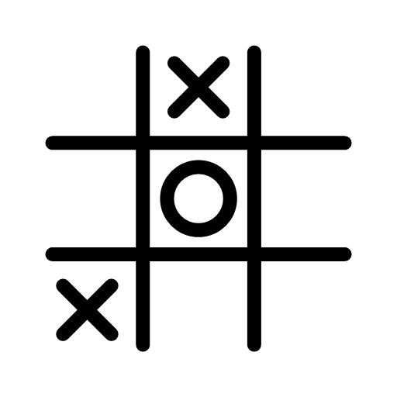
Tic-tac-toe by q-learning
Khandker Sadia Rahman
Department of Computer Science

Slide 2
OVERVIEW
Main reference
Problem statement
Main idea
Tic Tac Toe model
Plan and milestone
Summary
Basic Notations
Q learning
Demo
Next step

Slide 3
MAIN REFERENCE
Code
Pseudocode
https://www.cs.swarthmore.edu/~meeden/cs63/f11/lab6.php
Video lectures
https://www.youtube.com/playlist?list=PLZbbT5o_s2xoWNVdDudn51XM8lOuZ_Njv
Book chapter
https://www.cs.swarthmore.edu/~meeden/cs63/f11/ml-ch13.pdf
https://github.com/khpeek/Q-learning-Tic-Tac-Toe

Slide 4
PROBLEM STATEMENT
x is the human player
o is the q learned player
Consists of two players: x and o
Model a program using Q learning so it learns to play tic-tac-toe
Goal is to train the q learned player so it can compete with the human player

Slide 5

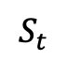
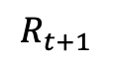
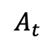
MAIN IDEA
Components of the model: environment, state, action, reward, agent
Goal is to use Q learning to maximize the total reward it receives.
At time $t$, the tic-tac-toe agent receives the current state, $S_{t}$
At time 𝑡, the tic-tac-toe agent receives the current state, 𝑆_𝑡
Depending on this state, the agent takes an action, $A_{t}$ following a policy $π$
Depending on this state, the agent takes an action, 𝐴_𝑡 following a policy 𝜋
Receives a reward $R_{t+1}$ for the action
Receives a reward 𝑅_(𝑡+1) for the action
Agent
$$S_{t}$$
$$A_{t}$$
$$R_{t+1}$$
Environment

Slide 6
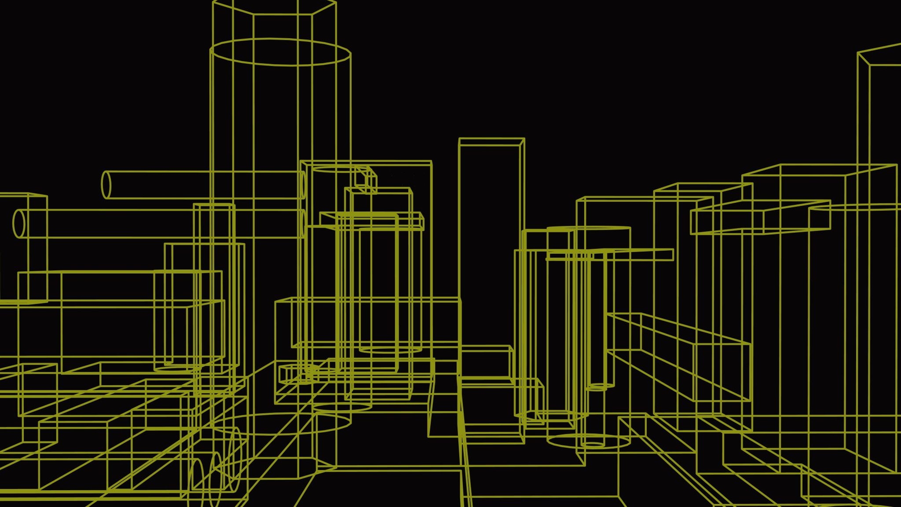
TIC TAC TOE

Slide 7

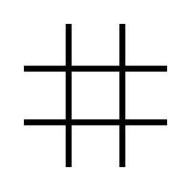

Components Of TIC TAC TOE Model
Environment: $3×3$ board
1
2
3
4
5
6
7
8
9

Slide 8


Components Of TIC TAC TOE Model
State of the board after every move
1
2
3
4
5
6
7
8
9
mark of the current player
(X or O)
9 positions of the board
1
2
3
4
5
6
7
8
9
1
2
3
4
5
6
7
8
9
9
0
9
9
1
0
9
9
9
X
1
9
9
9
0
1
9
9
9
O

Slide 9
Components Of TIC TAC TOE Model
Action: Player placing mark at any available position of the board
Available moves
1: (0,0)
3: (0,2)
4: (1,0)
6: (1,2)
7: (2,0)
8: (2,1)
9: (2,2)
1
2
3
4
5
6
7
8
9
9
0
9
9
1
0
9
9
9
X

Slide 10
Components Of TIC TAC TOE Model
Reward after every game
If X win, reward = 1
If draw, reward = 0.5
If O wins, reward = -1

Slide 11
Components Of TIC TAC TOE Model
Agents of the game
During learning process:
Two computer or Q players (X and O) act as the agents
Agents play against each other repeatedly
X tries to maximize the score >> Maximizer
O tries to minimize the score >> Minimizer
If X win, reward = 1
If O wins, reward = -1

Slide 12
BASICS Notation

Slide 13
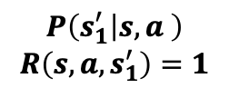
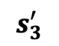
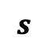
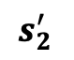
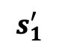
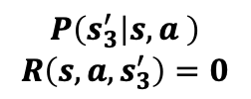
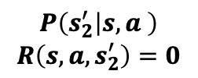
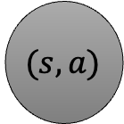
Markov Decision Process
$$P\left(s_{1}^{′} | s,a \right)$$
$$R\left(s,a,s_{1}^{′}\right)=1$$
$$s_{1}^{′}$$
$$(s,a)$$
An extension of Markov model
$$P\left(s_{2}^{′} | s,a \right)$$
$$R\left(s,a,s_{2}^{′}\right)=0$$
$$s_{2}^{′}$$
$$s$$
Adds a possibility of making a choice at every state
$$P\left(s_{3}^{′} | s,a \right)$$
$$R\left(s,a,s_{3}^{′}\right)=0$$
Adds a reward as a feedback from the environment
$$s_{3}^{′}$$

Slide 14
Reward
Goal is to maximize the total expected reward, $R_{t}$
Goal is to maximize the total expected reward, 𝑅_𝑡
$$R_{t}=r_{t+1}+r_{t+2}+r_{t+3}+…+r_{T}$$
𝑅_𝑡=𝑟_(𝑡+1)+𝑟_(𝑡+2)+𝑟_(𝑡+3)+…+𝑟_𝑇
Problems with this approach:
The sum could go to infinity and may not converge
Future rewards and immediate rewards are given the same priority
To fix this, we refine $R_{t}$ by prioritizing the immediate rewards over the later rewards with the help of discount factor, $γ (0≤γ≤1)$
To fix this, we refine 𝑅_𝑡 by prioritizing the immediate rewards over the later rewards with the help of discount factor, γ (0≤𝛾≤1)
$$R_{t}=r_{t+1}+γr_{t+2}+γ^{2}r_{t+3}+…+{γ^{T−1}r}_{T}$$
𝑅_𝑡=𝑟_(𝑡+1)+𝛾𝑟_(𝑡+2)+𝛾^2 𝑟_(𝑡+3)+…+〖𝛾^(𝑇−1) 𝑟〗_𝑇
$$=r_{t+1}+γR_{t+1}$$
=𝑟_(𝑡+1)+𝛾𝑅_(𝑡+1)

Slide 15
Value Function
These functions measures how good a state or an action is.
State value: expected total reward starting from $s$ at $t$ and following policy $π$ thereafter
State value: expected total reward starting from 𝑠 at 𝑡 and following policy 𝜋 thereafter
$$V_{π}\left(s\right)=E\left[R_{t} | s_{t}=s\right]$$
𝑉_𝜋 (𝑠)=𝐸[𝑅_𝑡│𝑠_𝑡=𝑠]
Action value: expected total reward starting from $s$ and taking an action $a$ at $t$ and following policy $π$ thereafter
Action value: expected total reward starting from 𝑠 and taking an action 𝑎 at 𝑡 and following policy 𝜋 thereafter
$$Q_{π}\left(s,a\right)=E\left[R_{t} | s_{t}=s,a_{t}=a\right]$$
𝑄_𝜋 (𝑠,𝑎)=𝐸[𝑅_𝑡│𝑠_𝑡=𝑠,𝑎_𝑡=𝑎]

Slide 16
Value Function At Optimality
Optimal State value: expected total reward starting from $s$ at $t$ and following the optimal policy $π$ thereafter
Optimal State value: expected total reward starting from 𝑠 at 𝑡 and following the optimal policy 𝜋 thereafter
$$V_{π}^{∗}\left(s\right)=\max_{π} Q^{∗}(s,a)$$
𝑉_𝜋^∗ (𝑠)=max┬𝜋 𝑄^∗ (𝑠,𝑎)
Optimal Action value: expected total reward starting from $s$ and taking an action $a$ at $t$ and following optimal policy $π$ thereafter
Optimal Action value: expected total reward starting from 𝑠 and taking an action 𝑎 at 𝑡 and following optimal policy 𝜋 thereafter
$$Q_{π}^{∗}\left(s,a\right)=\sum_{s^{′}}{T\left(s,a,s^{′}\right)\left[R(s,a,s′)+γV_{π}^{∗}\left(s^{′}\right)\right] }$$
𝑄_𝜋^∗ (𝑠,𝑎)=∑_(𝑠^′)▒𝑇(𝑠,𝑎,𝑠^′ )[𝑅(𝑠,𝑎,𝑠′)+𝛾𝑉_𝜋^∗ (𝑠^′ )]" "
$T\left(s,a,s^{′}\right)$ is the transition probabilities and $R(s,a,s′)$ is the reward
𝑇(𝑠,𝑎,𝑠^′ ) is the transition probabilities and 𝑅(𝑠,𝑎,𝑠′) is the reward

Slide 17
Bellman’s Equation
Value Iteration
$$V_{π}^{∗}\left(s\right)=\max_{a}\sum_{s^{′}}{T\left(s,a,s^{′}\right)\left[R\left(s,a,s^{′}\right)+γV_{π}^{∗}\left(s^{′}\right)\right] }$$
𝑉_𝜋^∗ (𝑠)=max┬𝑎 ∑_(𝑠^′)▒𝑇(𝑠,𝑎,𝑠^′ )[𝑅(𝑠,𝑎,𝑠^′ )+𝛾𝑉_𝜋^∗ (𝑠^′ )]" "
Q-value Iteration
$$Q_{π}\left(s,a\right)=\sum_{s^{′}}{T\left(s,a,s^{′}\right)\left[R\left(s,a,s^{′}\right)+γ\max_{π} Q^{∗}(s′,a′)\right] }$$
𝑄_𝜋 (𝑠,𝑎)=∑_(𝑠^′)▒𝑇(𝑠,𝑎,𝑠^′ )[𝑅(𝑠,𝑎,𝑠^′ )+𝛾 max┬𝜋 𝑄^∗ (𝑠′,𝑎′)]" "
Since in general, $T\left(s,a,s^{′}\right)$ and $R\left(s,a,s^{′}\right)$ are unknown, sample-based learning is adopted
Since in general, 𝑇(𝑠,𝑎,𝑠^′ ) and R(𝑠,𝑎,𝑠^′ ) are unknown, sample-based learning is adopted
$$Q\left(s,a\right)=\left(1−α\right)Q\left(s,a\right)+α(R\left(s,a,s^{′}\right)+γ\max_{π} Q(s′,a′))$$
𝑄(𝑠,𝑎)=(1−𝛼)𝑄(𝑠,𝑎)+𝛼(𝑅(𝑠,𝑎,𝑠^′ )+𝛾 max┬𝜋 𝑄(𝑠′,𝑎′))
In the case where $T\left(s,a,s^{′}\right)$ and $R\left(s,a,s^{′}\right)$ are unknown, sample-based learning is difficult to adopted
In the case where 𝑇(𝑠,𝑎,𝑠^′ ) and R(𝑠,𝑎,𝑠^′ ) are unknown, sample-based learning is difficult to adopted

Slide 18
Policy
Policy is a function that dictates what to do when in a certain state
Goal is to find the policy that maximizes the reward
Optimal policy can be determined by:
$$π\left(s\right)={argmax}_{a}Q^{∗}(s,a)$$
𝜋(𝑠)=argmax_𝑎 𝑄^∗ (𝑠,𝑎)

Slide 19
Q learning

Slide 20
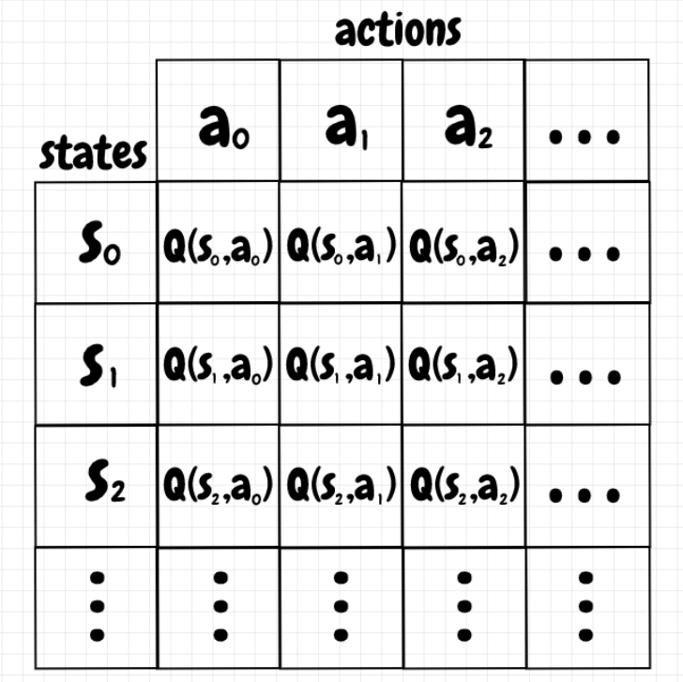
TIC-TAC-TOE WITH TABULAR Q-LEARNING
Creates a table consisting of all possible states and action at each axis correspondingly
Q-value in each cell indicates whether it is a good idea to take that action from the current state

Slide 21
Q Values
What do we do with the Q values?
Check the Q values for each actions for a given state and choose the one with the best value
Indicates how useful a given action is in securing future rewards
Q is the quality score assigned to a state - action pair i.e., $Q\left(s,a\right)→ℝ$
Q is the quality score assigned to a state - action pair i.e., 𝑄(𝑠,𝑎)→ℝ
What is a Q value?
Minimizer chooses the minimum Q value
Maximizer chooses the maximum Q value

Slide 22
Q Values
Create a Q table with rows for every possible state
Initialize the values uniformly for every state
For the final move, the reward stored as its new Q value
For all the other moves, Q values are updates using: $Q\left(s,a\right)=\left(1−α\right)Q\left(s,a\right)+α(R\left(s,a,s^{′}\right)+γ\max_{π} Q(s′,a′))$
For all the other moves, Q values are updates using: 𝑄(𝑠,𝑎)=(1−𝛼)𝑄(𝑠,𝑎)+𝛼(𝑅(𝑠,𝑎,𝑠^′ )+𝛾 max┬𝜋 𝑄(𝑠′,𝑎′))
What to initialize with?
Pessimistic initialization:
Initializes with 0 and assumes every move will lead to a loss
Optimistic initialization:
Initializes with 1 and assumes every move will lead to a win
How to compute the Q values?

Slide 23
Q-LEARNING ALGORITHM
Initialize Q-table
Choose an action
Perform an action
Until the Q values converges
Measure the reward
Update Q-table

Slide 24
Exploration And Exploitation
How we do this?
Epsilon greedy strategy
Exploitation
Exploration
Act of exploring the environment to find out information about it
Act of exploiting the information already known about the environment to maximize the reward
If draw, reward = 0.5
If X win, reward = 1

Slide 25
Epsilon Greedy Strategy
At each step, a random number ($n$) is generated between 0 and 1.
At each step, a random number (𝑛) is generated between 0 and 1.
If $n>ε$, the agent chooses its next step via exploitation i.e., chooses the action with the highest Q value
If 𝑛>𝜖, the agent chooses its next step via exploitation i.e., chooses the action with the highest Q value
Otherwise, the agent chooses action via exploration i.e., randomly chooses an action
It allows the agent to choose some of its moves randomly

Slide 26
Demonstration

Slide 27
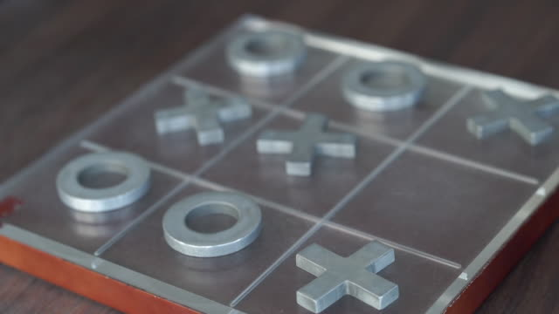
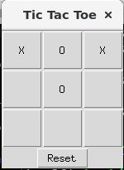
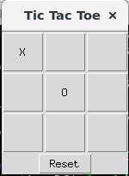
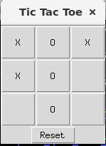
Expected outcome
Fully functional tic-tac-toe game

Slide 28
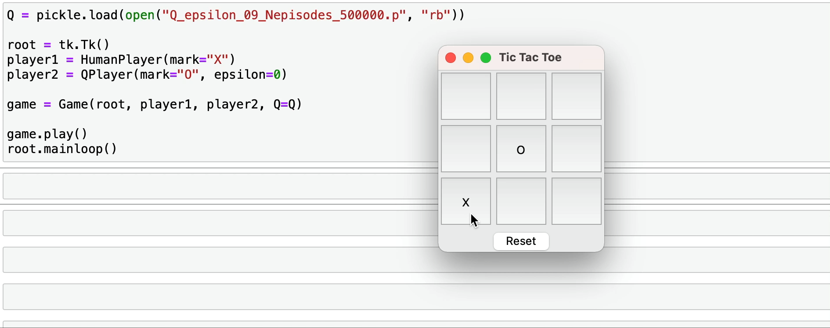
Demo at 500000

Slide 29
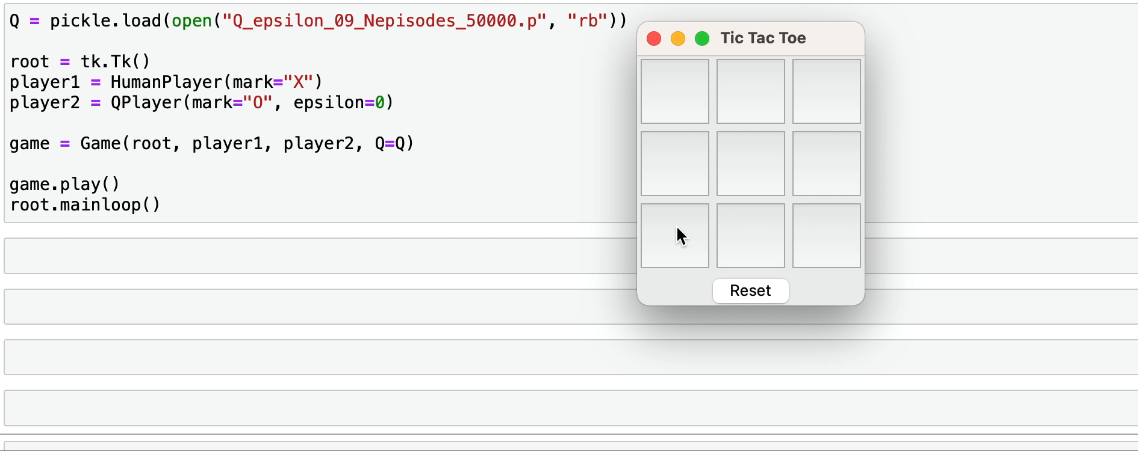
Demo at 50000

Slide 30
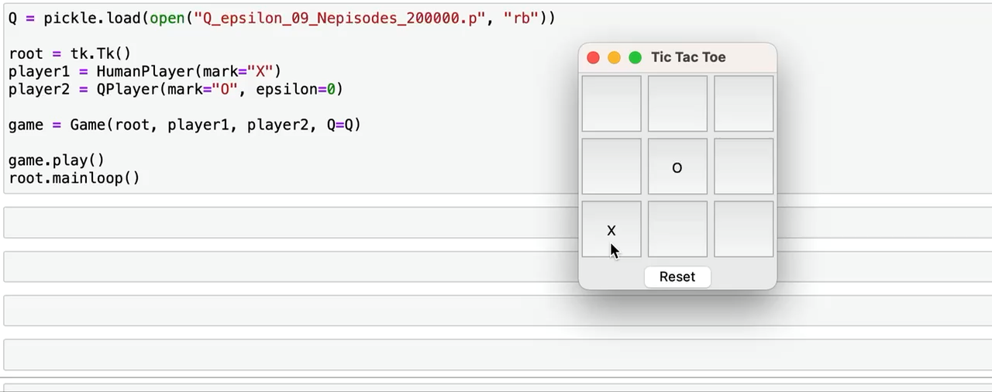
Demo at 200000

Slide 31

Plan And Milestone
Dates | Tentative goals
9/28/2021 | Initial presentation
10/12/2021 | Conceptual understanding on Q learning
10/26/2021 | Implementation of the pseudocode and code
11/9/2021 | Mid presentation
11/23/2021 | Extension of code
11/30/2021 | Final presentation

Slide 32
Next step
Upgrade the exploration criterion
Extension
Greedy epsilon strategy causes the game to choose randomly even when the Q values are learnt.
Two solutions:
- Lower the value of epsilon over time
- Use exploration functions
Apply Q learning to a 4 by 4 grid

Slide 33

SUMMARY
Basic Notation
Q learning
Demonstration
Tic tac toe model

Slide 34

Thank you

Slide 35

Appendix

Slide 36
References
https://medium.com/@carsten.friedrich/part-3-tabular-q-learning-a-tic-tac-toe-player-that-gets-better-and-better-fa4da4b0892a
https://towardsdatascience.com/math-of-q-learning-python-code-5dcbdc49b6f6
https://towardsdatascience.com/math-behind-reinforcement-learning-the-easy-way-1b7ed0c030f4

Slide 37
References
https://www.pico.net/kb/what-algorithm-for-a-tic-tac-toe-game-can-i-use-to-determine-the-best-move-for-the-ai/
https://www.neverstopbuilding.com/blog/minimax
https://web.archive.org/web/20200507202433id_/https://www.annualreviews.org/doi/pdf/10.1146/annurev-statistics-031219-041220
https://nestedsoftware.com/2019/12/27/tic-tac-toe-with-a-neural-network-1fjn.206436.html

